Slide 1




PIXTREAM
Create, Engage & Share
We are glad to present our project entitled ‘Pixtream’, prepared as part of our Mini project. It is a mini social media web application designed for sharing pots and connecting users through posts, likes, comments, and messages
Sain Saburaj
MCA23

Slide 2



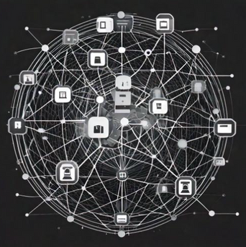


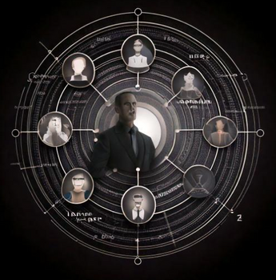
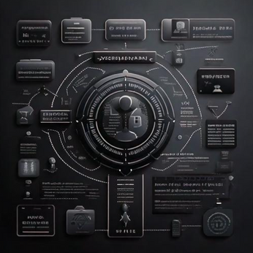

ABOUT
OUR SOFTWARE
What is Pixtream?
Pixtream is a mini social media platform designed for users to share photos and connect with friends and followers. It emphasizes user engagement and personalized experiences through tailored content and recommendations.
Pixtream offers:
Uploading and sharing posts
Liking, commenting, and saving content
Following and unfollowing users Direct messaging for seamless communication
Users receive dynamic suggestions for people to follow and posts to view based on their interests and interactions. This ensures a unique and engaging experience tailored to individual preferences.
Admins play a crucial role in maintaining a safe environment by managing user complaints and reports. Users can report inappropriate content and block users, ensuring a respectful community.

Slide 3
OUR
PROJECT
1
PIXTREAM
Pixtream is a social media platform that allows users to share posts, connect with others, and engage with personalized content based on their interests.
2
DYNAMIC SUGGESTIONS
Algorithms can suggest users dynamically by comparing the current user's interests with other users and prioritize those with the highest overlap in interests or activities.
3
ADMIN CONTROLLED
Admin ensures the smooth functioning of the platform by managing key administrative functions.

Slide 4
SOFTWARE
OBJECTIVES
1
Facilitate User Interaction: Enable users to easily share posts, follow others, and engage with content through likes, comments, and messaging.
2
Dynamic Experience: Provide dynamic content and user suggestions based on individual interests and preferences.
3
Community Moderation: Ensure a safe environment by managing user complaints and reports.
4
Scalability and Simplicity: Build a lightweight, scalable platform that remains user-friendly while supporting future feature expansions

Slide 5


SYSTEM
USERS
There are mainly 2 users in this web application.
They are admin and users.
ADMIN
USERS
The admin can manage user complaints and reports, review and approve reports of misconduct, restrict or delete user accounts based on violations, and handle platform-wide issues.
The users are the core participants who can create profiles, upload posts, like, comment, share, and save posts. They can follow or unfollow other users, send and receive messages, and block users if necessary.

Slide 6
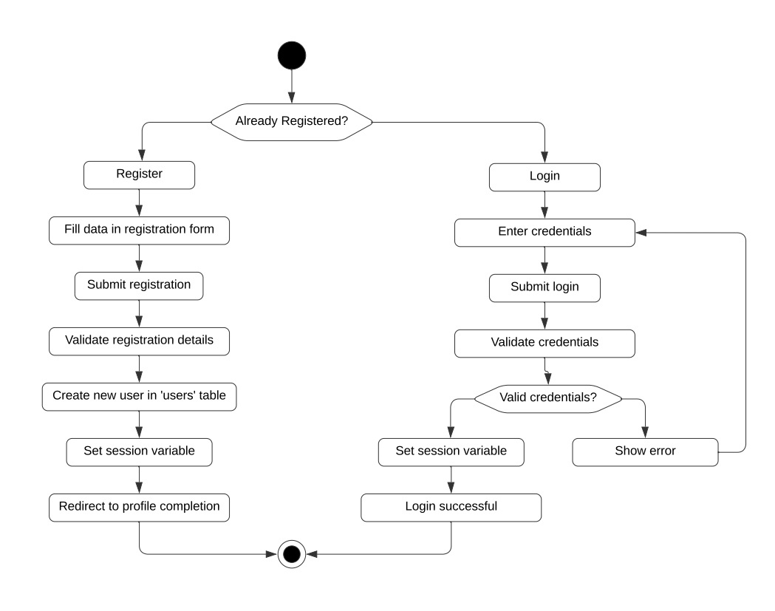

ACTIVITY
DIAGRAM
USER REGISTRATION, LOGIN

Slide 7

ACTIVITY
DIAGRAM
USER REGISTRATION, LOGIN
In Pixtream, the login and registration processes are designed to provide users with a seamless entry into the platform while ensuring their information is secure. During registration, new users create an account by providing essential details such as their name, username, email address, and password. This information is used to establish their unique profile on the platform. Upon successful registration, users receive a confirmation, granting them access to all features of Pixtream. The login process requires users to enter their registered username and password, allowing them to authenticate their identity and access their profiles. This streamlined login and registration system ensures that users can easily join the community and engage with the platform while maintaining their account's security.

Slide 8
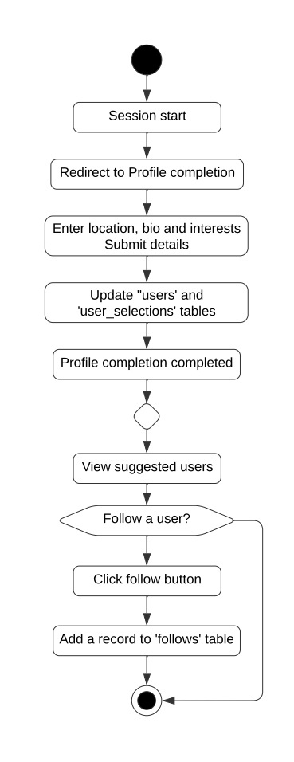


ACTIVITY
DIAGRAM
CREATE PROFILE, SELECT INTERESTS, FOLLOW USERS
In Pixtream, users begin their journey by creating a personalized profile that includes essential information such as their name, bio, profile picture, and location, allowing them to express their identity on the platform. After the registration process, users are prompted to select their interests from a curated list, which helps tailor their experience by influencing the content and user suggestions they receive. Once their profiles are set up, users can connect with others by following them, enabling a social network of updates and interactions. They also have the flexibility to unfollow users at any time, ensuring they maintain a feed that reflects their preferences and interests. This combination of profile creation, interest selection, and social connectivity fosters a dynamic and engaging environment for users on Pixtream.

Slide 9
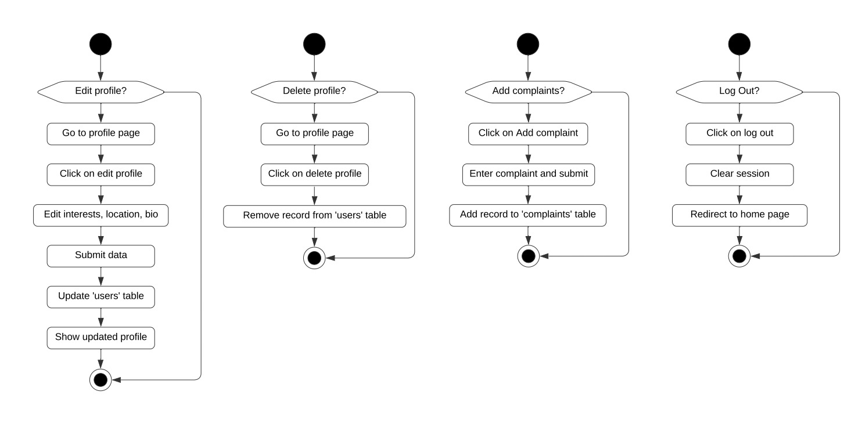
ACTIVITY
DIAGRAM
EDIT, DELETE USER PROFILE

Slide 10


ACTIVITY
DIAGRAM
EDIT, DELETE USER PROFILE
In Pixtream, users have the ability to edit and delete their profiles, providing them with full control over their personal information and online presence. The edit profile feature allows users to update their details, such as their bio, profile picture, and location, enabling them to reflect changes in their lives or preferences. This functionality ensures that their profile remains current and accurately represents them within the community. If a user decides to leave the platform or no longer wishes to maintain their account, they can opt to delete their profile. This action removes their account and all associated data from Pixtream, ensuring their privacy and giving them a clean exit from the platform. The process for both editing and deleting profiles is designed to be straightforward and user-friendly, allowing users to manage their online presence with ease and confidence.

Slide 11
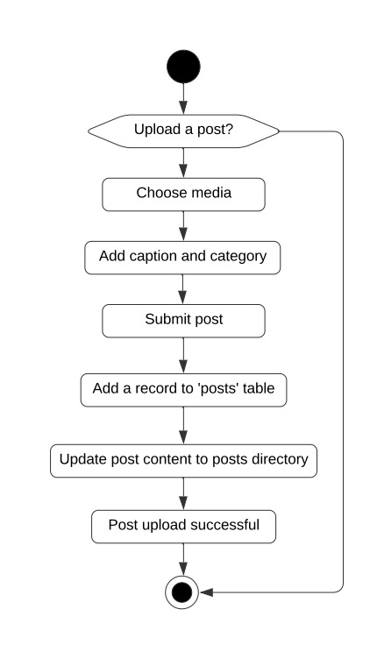

ACTIVITY
DIAGRAM
ADD NEW POSTS
In Pixtream, users can easily add posts to share their thoughts, experiences, or moments with their followers. The process begins with uploading media, where users can select media from their device and accompany them with a caption that provides context or insight into the content. Additionally, users can categorize their posts by selecting relevant tags, making it easier for others to discover and engage with their content. Once shared, these posts become visible in the feeds of followers, who can interact by liking, commenting, or sharing the posts further. This functionality not only encourages user expression but also promotes engagement within the community, allowing users to connect over shared interests and experiences through their visual storytelling.

Slide 12
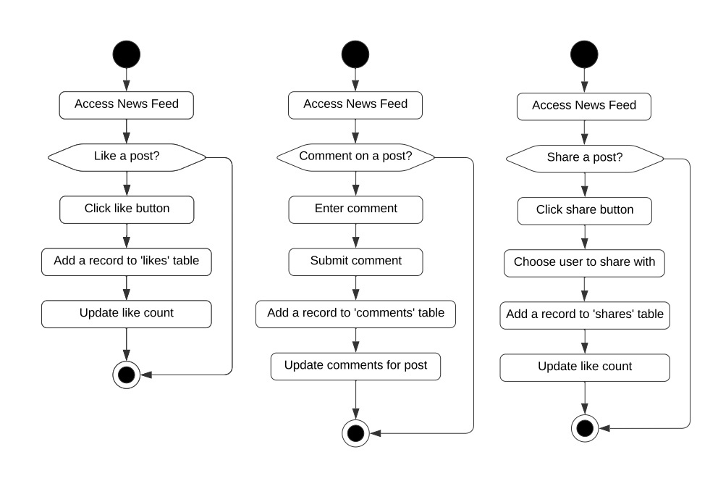
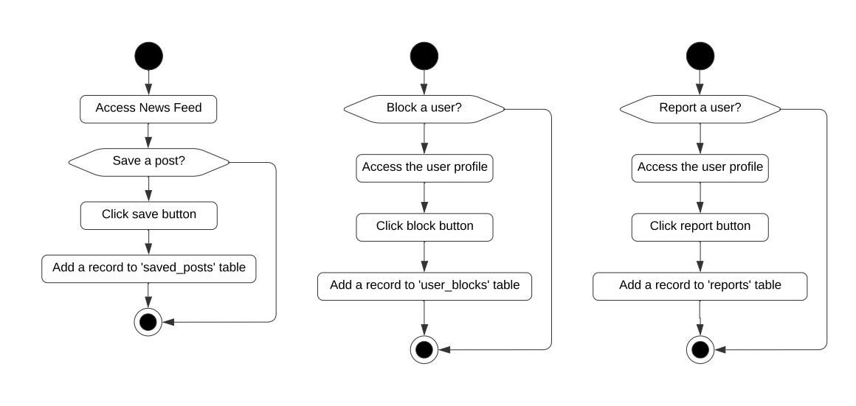
ACTIVITY
DIAGRAM
LIKE, SHARE, COMMENT, SAVE

Slide 13




ACTIVITY
DIAGRAM
LIKE, SHARE, COMMENT, SAVE
In Pixtream, users can engage with content through various interactive features such as liking, sharing, commenting, and saving posts. When a user comes across a post they enjoy, they can express their appreciation by liking it, which not only boosts the visibility of the post but also encourages the creator. Additionally, users have the option to share posts with their followers or directly via messaging, expanding the reach of the content and fostering discussions beyond the original post. Comments enable users to engage in conversations around the posts, allowing them to provide feedback, ask questions, or simply express their thoughts. For posts that resonate particularly well, users can save them to a personal collection for easy access later, ensuring they can revisit their favorite content whenever they want. Together, these features enhance the interactive experience on Pixtream, promoting a vibrant community where users can connect and share their interests effectively.

Slide 14
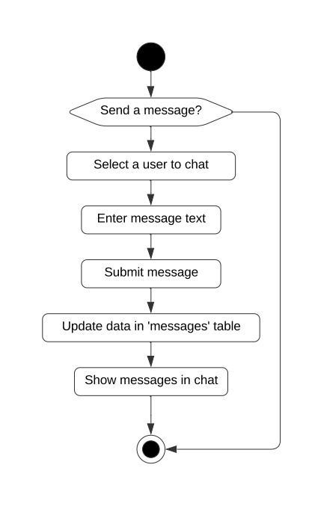

ACTIVITY
DIAGRAM
MESSAGE USERS
In Pixtream, the chat feature facilitates direct messaging between users, enhancing communication and connection within the platform. This functionality allows users to send private messages to one another, enabling them to have one-on-one conversations without the need for public visibility. Users can share thoughts, experiences, or even links to posts directly through chat, making interactions more personal and immediate. The chat interface is designed for ease of use, allowing users to view conversation history. This real-time communication fosters deeper relationships among users, encouraging engagement and collaboration while helping to build a supportive community within Pixtream.

Slide 15
ACTIVITY
DIAGRAM
BLOCK, REPORT USERS

Slide 16

ACTIVITY
DIAGRAM
BLOCK, REPORT USERS
In Pixtream, the block and report features empower users to manage their interactions and maintain a safe and respectful environment. The block feature allows users to restrict specific individuals from viewing their profile, posts, or sending messages, giving them control over their social connections and protecting their experience on the platform. When a user feels threatened, harassed, or encounters inappropriate behavior, they can utilize the report feature to alert the platform's admin. This functionality enables users to submit complaints regarding specific content or users, prompting an investigation into the reported issue. The admin then reviews these reports to take appropriate actions, which may include warnings, restrictions, or account deletion. Together, these features ensure that users have the necessary tools to create a safe and enjoyable experience on Pixtream while fostering a supportive community.

Slide 17
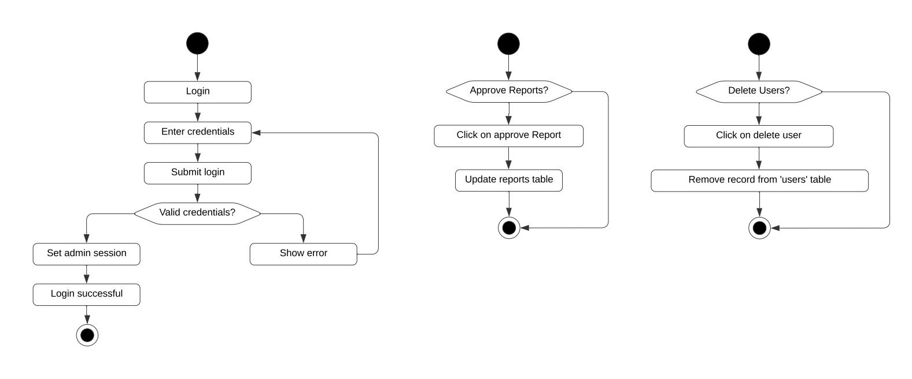
ACTIVITY
DIAGRAM
ADMIN LOGIN

Slide 18

ACTIVITY
DIAGRAM
ADMIN LOGIN
In Pixtream, the admin login process is designed to ensure secure access to administrative features and functionalities that are crucial for managing the platform. Admins enter their registered username and password on the login page, which authenticates their identity and grants them access to the admin dashboard. This dashboard provides tools for overseeing user activity, handling complaints and reports, moderating content, and managing user accounts. The admin login system incorporates security measures, such as encrypted passwords and possibly two-factor authentication, to protect sensitive administrative functions from unauthorized access. Once logged in, admins can efficiently monitor the platform, enforce community guidelines, and maintain a safe and enjoyable environment for all users.

Slide 19
ACTIVITY
DIAGRAM
ADMIN APPROVAL, COMPLAINTS

Slide 20

ACTIVITY
DIAGRAM
ADMIN APPROVAL, COMPLAINTS
In Pixtream, the admin plays a crucial role in maintaining platform integrity through the approval and complaints processes. When users report inappropriate behavior or content, the admin receives these reports for review and assessment. They evaluate the details and context surrounding each case, determining whether to approve actions like temporary suspensions, or permanent deletions of offending accounts. Additionally, users can submit complaints about various issues they encounter on the platform, such as technical problems or concerns about community standards. The admin addresses these complaints, ensuring that user feedback is taken seriously and that the platform remains a safe and enjoyable space for all users. By actively managing both approvals and complaints, the admin fosters a supportive environment and helps uphold community guidelines.

Slide 21
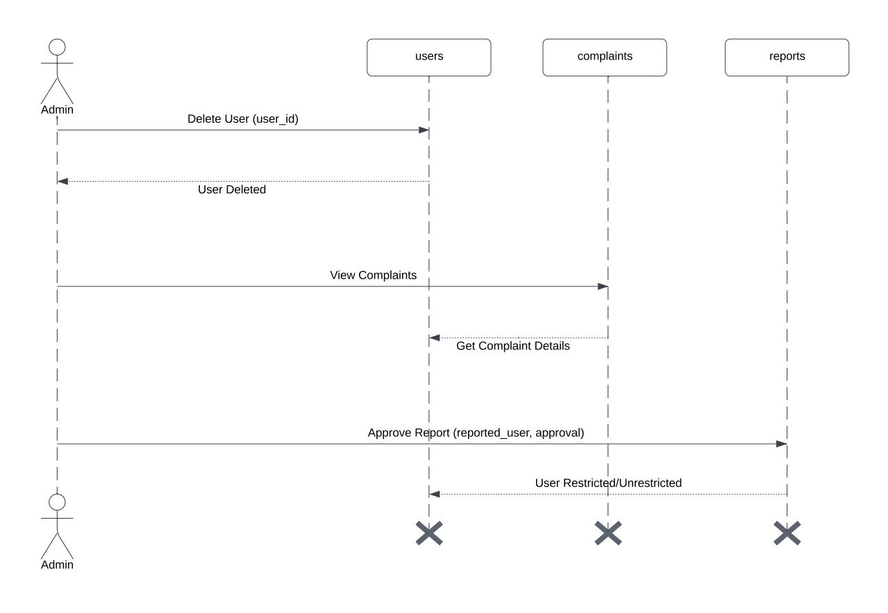
SEQUENCE
DIAGRAM
ADMIN ACTIONS

Slide 22
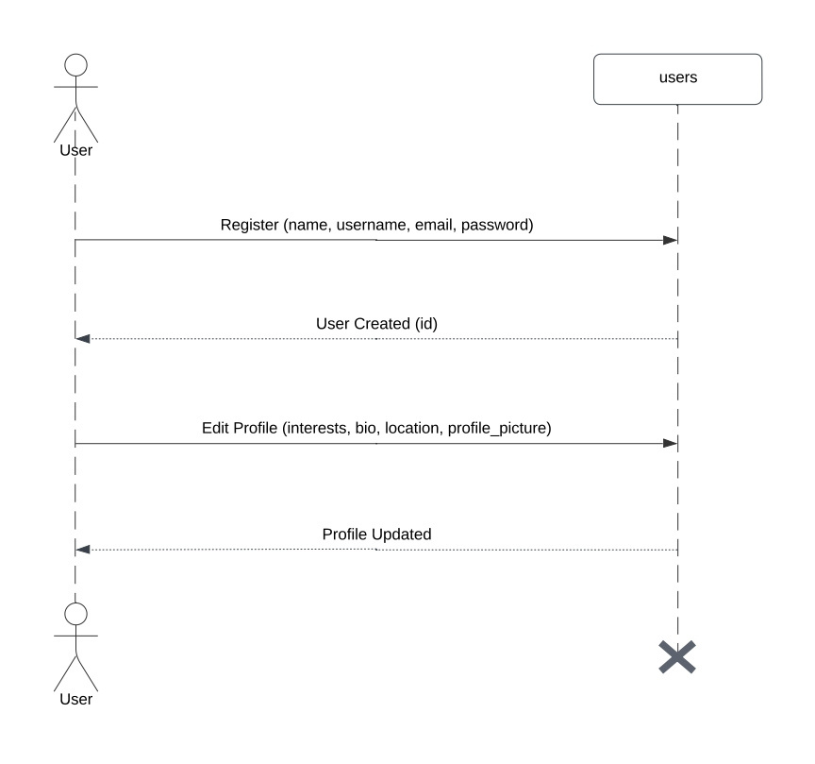
SEQUENCE
DIAGRAM
USER ACTIONS

Slide 23
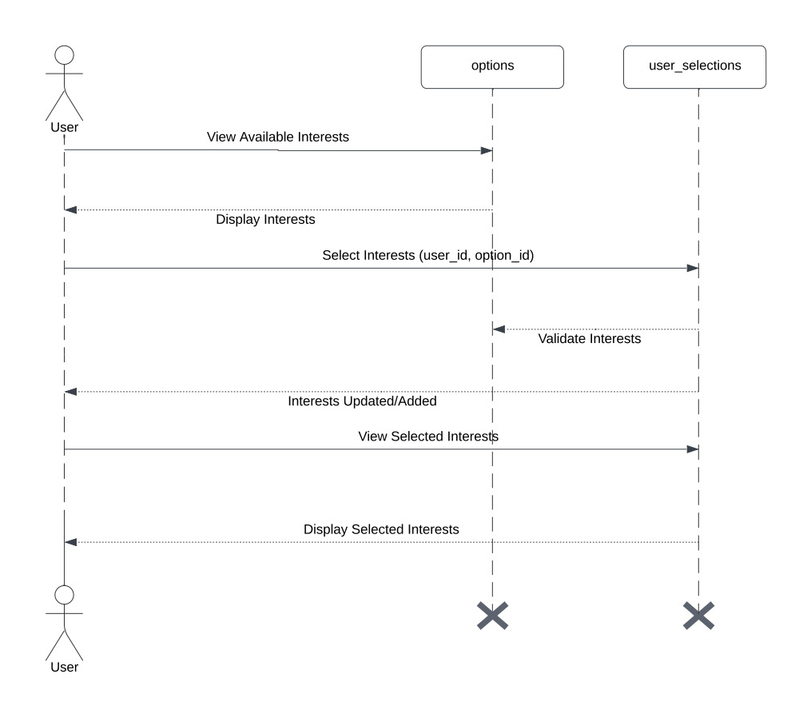
SEQUENCE
DIAGRAM
SELECTION OF USER INTERESTS

Slide 24
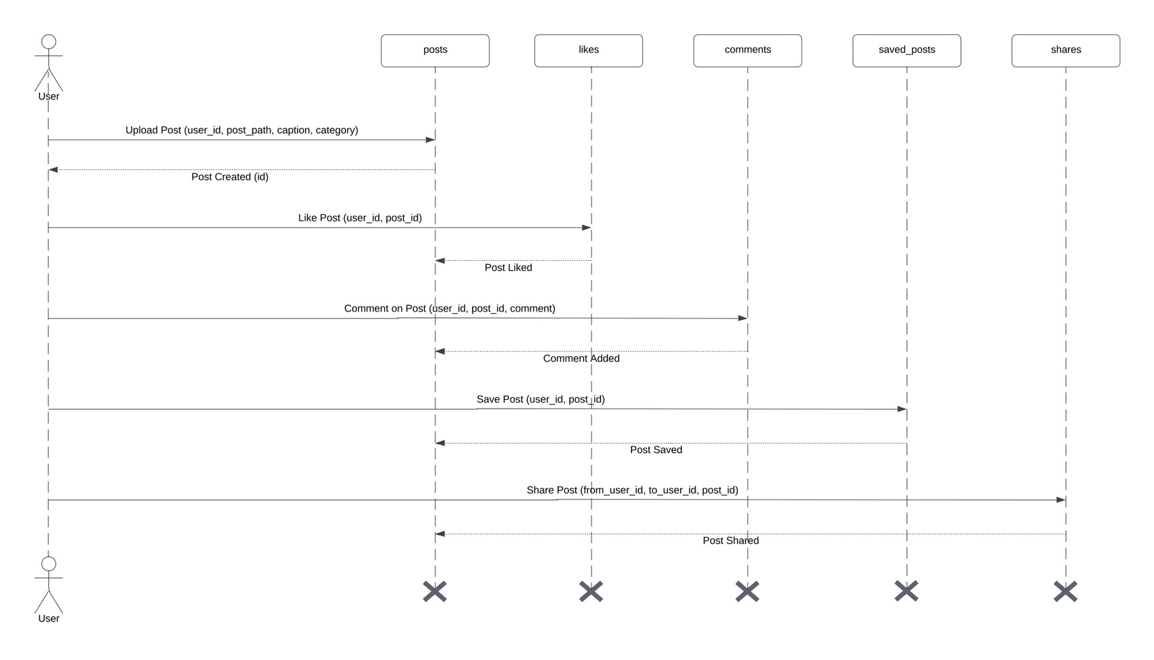
SEQUENCE
DIAGRAM
INTERACTION WITH POSTS

Slide 25
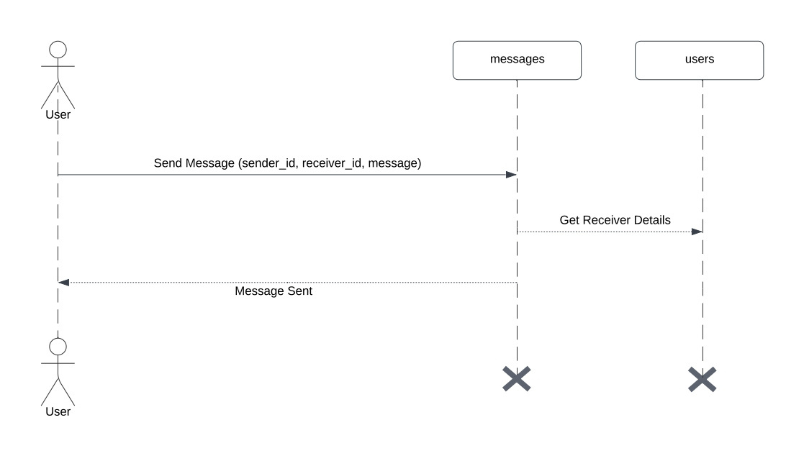
SEQUENCE
DIAGRAM
MESSAGING

Slide 26
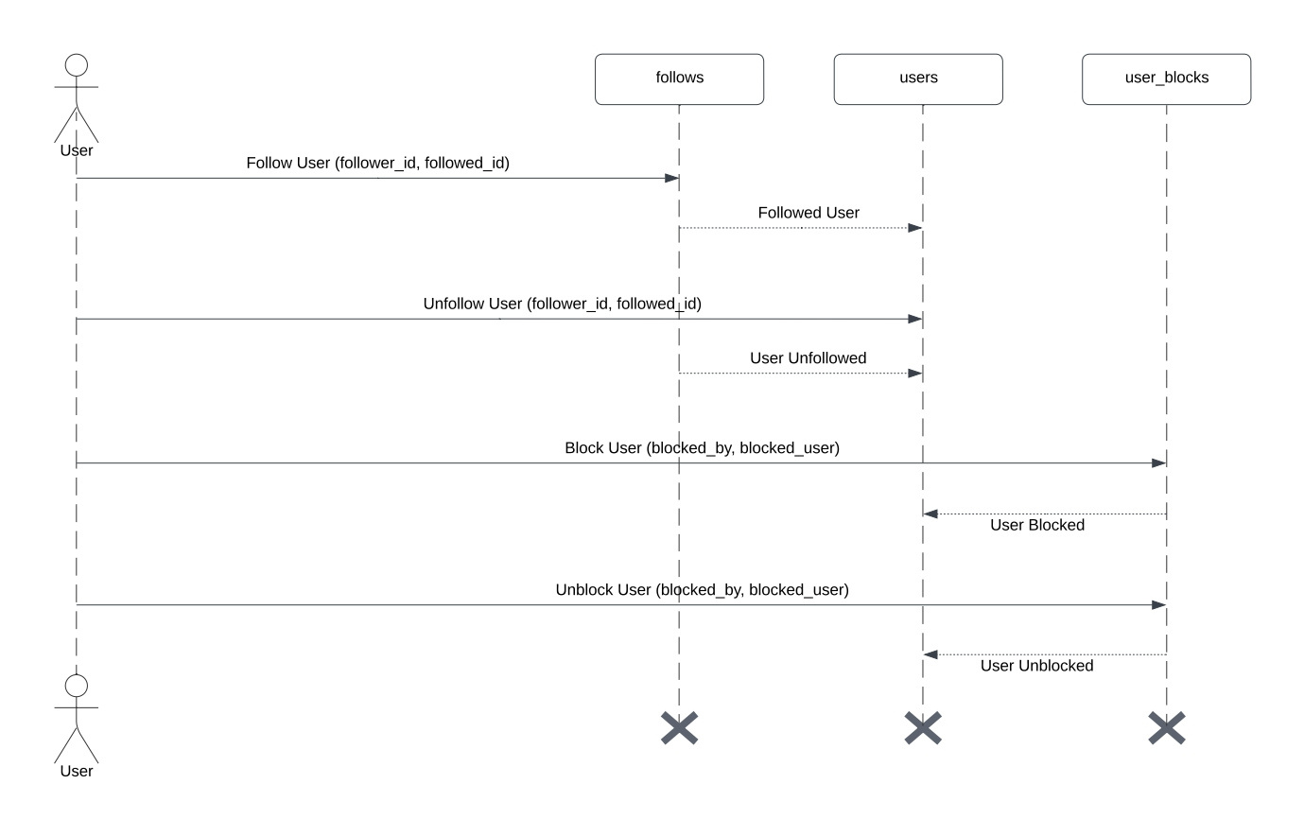
SEQUENCE
DIAGRAM
FOLLOW-UNFOLLOW
BLOCK-UNBLOCK

Slide 27
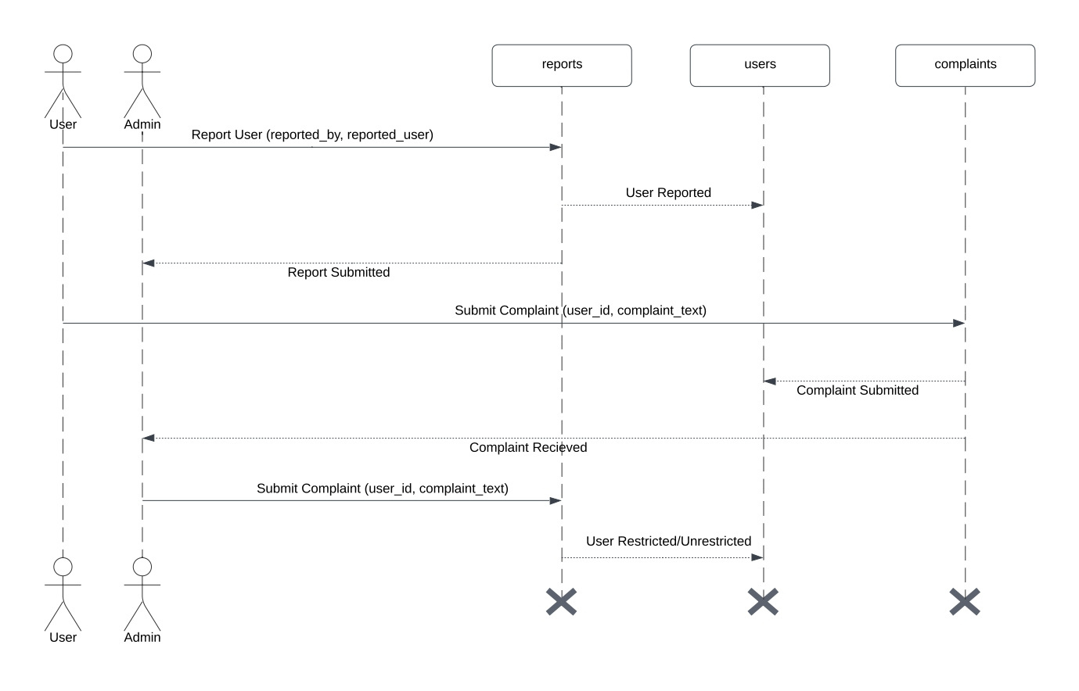
SEQUENCE
DIAGRAM
REPORT USER
SUBMIT COMLAINTS

Slide 28
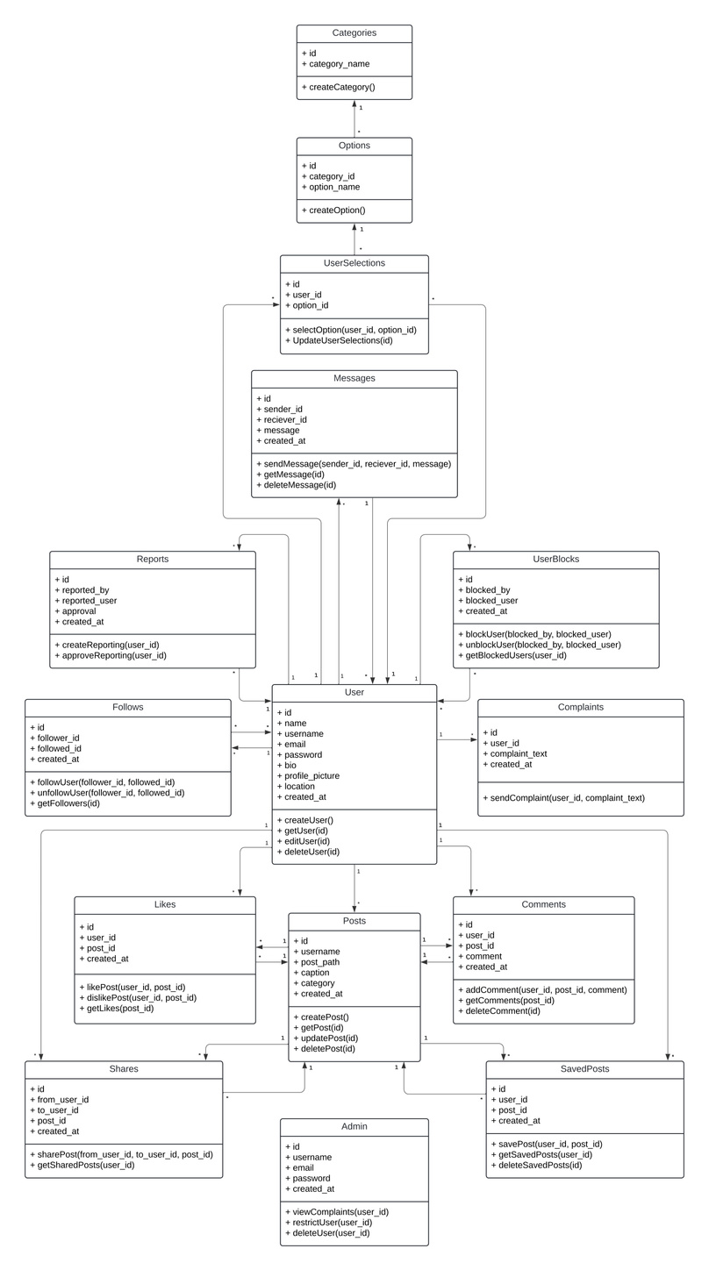
CLASS
DIAGRAM
Key Components of the Class Diagram:
User: Represents users of the platform, including attributes like id, name, username, email, password, and methods for creating, editing, and deleting user profiles.
Posts: Represents the posts shared by users, containing attributes like id, username, post_path, caption, and methods for creating, updating, and deleting posts.
Messages: Captures the messaging functionality, including attributes for id, sender_id, receiver_id, and methods to send and retrieve messages.
Follows: Represents the relationship between users, tracking who follows whom with attributes for id, follower_id, and followed_id.
Likes, Comments, Shares, Saved Posts: Each of these classes tracks interactions with posts, including who liked or commented on a post, and how posts are shared or saved.
Admin: Represents administrative functions, allowing for user management, including attributes like id, username, email, and methods for viewing complaints and reports.
Complaints and Reports: These classes track user complaints and reports about other users or content, containing attributes that link back to the User class for accountability.

Slide 29
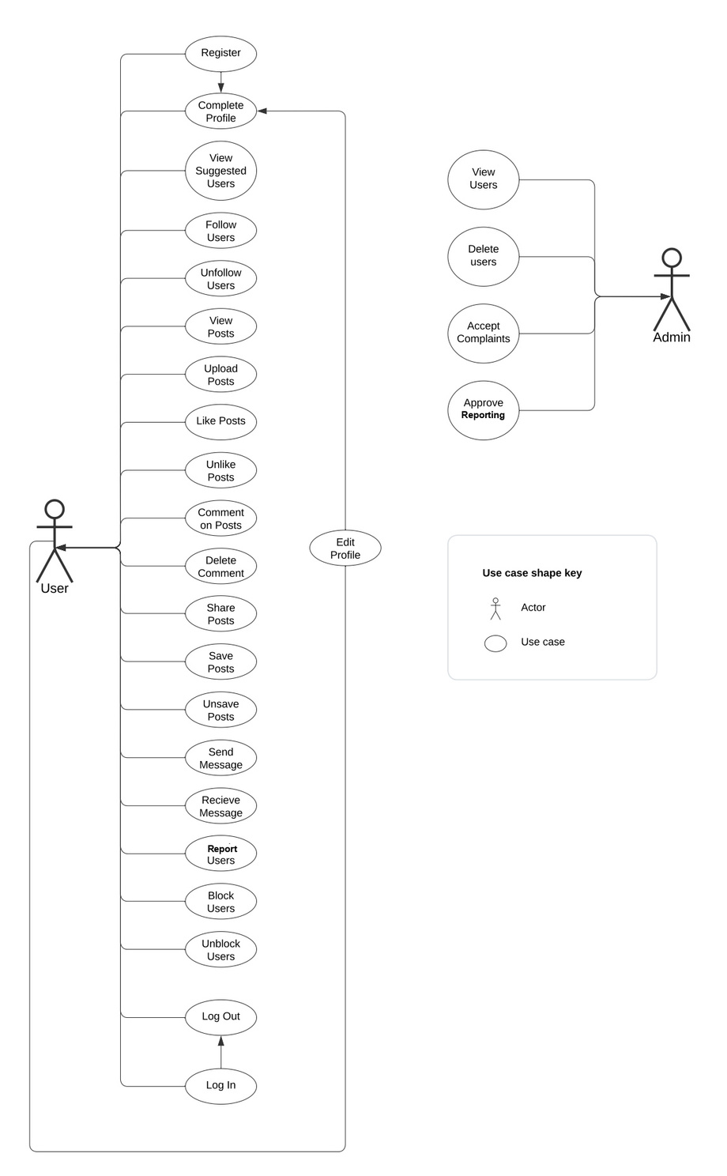
USE CASE
DIAGRAM
Main actors: Admin, Users
User: The User is a primary actor who interacts with the Pixtream platform to engage in various social media activities. They can register and create a personal profile, upload and share posts, and connect with others by following or unfollowing users. Users can like, comment on, and save posts to personalize their experience. Additionally, they can send direct messages to other users for private communication and have the ability to block or unblock users to manage their interactions. If they encounter inappropriate content or behavior, users can report such instances to the platform's admin. The overall experience for users is designed to foster community engagement and enable seamless interaction with content and other members of the platform.
Admin: The Admin is a secondary actor responsible for maintaining the integrity and safety of the Pixtream platform. Admins have access to a suite of management tools that allow them to monitor user activity and enforce community guidelines. They can review and respond to reports and complaints submitted by users, assessing issues related to inappropriate content or behavior. Admins also have the authority to approve or restrict user accounts based on violations of platform rules. Additionally, they can manage user accounts by editing or deleting profiles as necessary, ensuring a safe and enjoyable environment for all users. The admin's role is crucial for fostering a positive community and upholding the platform's standards.

Slide 30







USED
PLATFORM
1
FRONTEND
2
BACKEND
3
IDE
HTML5
PHP
VISUAL STUDIO CODE
CSS
MYSQL
BOOTSTRAP
JAVASCRIPT

Slide 31

WE
CONCLUDE
Thank you for your attention!
Pixtream is a mini social media platform designed for users to share photos, connect with friends, and engage with personalized content based on their interests. We aim to create a vibrant community where users can express themselves, interact meaningfully, and discover new connections.
Thank You!

Slide 32

Thank You!

